Slide 1
Week 4

Slide 2
Last week I said I would do…
Weekend extension of release (done by Monday):
Fix the SSH connection.
Objectives for Next Week:
Code the perimetry Reading GUI.(GUI0)
Code the transformation function.
Review and produce final experiment description.
Weekend extension of release (done by Monday):
Fix the SSH connection.
Objectives for Next Week:
Code the perimetry Reading GUI.(GUI0)
Code the transformation function.
Review and produce final experiment description.

Slide 3
Actually I’ve done
Weekend extension of release (done by Monday):
Fix the SSH connection.
Objectives for Next Week:
Code the perimetry Reading GUI.(GUI0)
Code the transformation function.
Review and produce final experiment description.

Slide 4
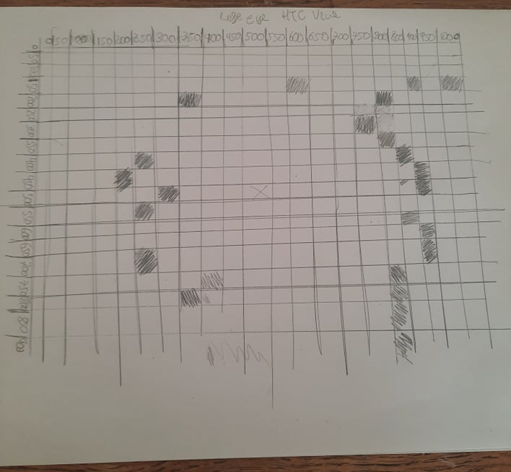
New script:HMD_fov_measure.py
Allows me to measure how much of the VR screen is usable.

Slide 6
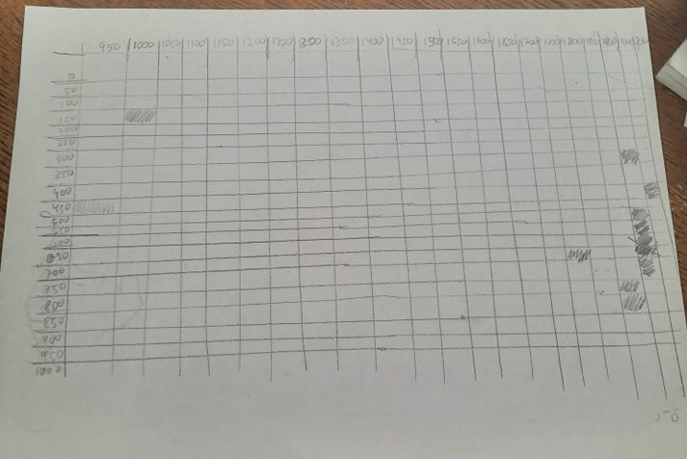


Slide 7
New Script:Perimetry_Reader.py
Allows us to measure the borders of the users visual field on the screen.
-Missing, not running properly.

Slide 8
Not achieved this week: transforms.
Transform function.
Created using the output of Perimetry_reader.py
Programmed using the results from HMD_fov_measure.py

Slide 9
Unexpected issues have come up
Where do I put the cameras?
I taped them to the VR set, but it is eyeballed.
Best answer: place them such that their framed intertwine ar the nose.
Shortcut: Compensate for lack of coordination with the transforms.
The resolution on the sides is not good at all.
Running HMD_fov_measure.py yesterday I noticed it is extremely difficult to

Slide 10
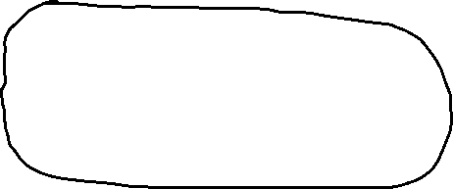







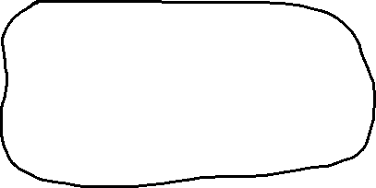
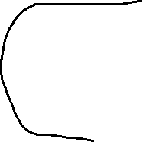
Going from this

Slide 11


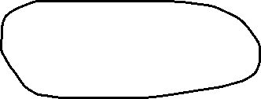



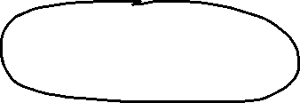

To this

Slide 12
Plan for next week THIS WEEK
Definitely: Complete the perimetry reading application
Most likely:Make the transformation program.
Opstimistically:Fix the left side of the pipeline.
Complete the pipeline!
Finally be able to stream content.

Slide 13
Perimetry reader prototype is up and running!
Perimetry_reader.py is up and running!

Slide 14
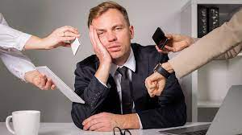
Tranformation functions still in the Works
We have a defined structure that will fit in with the perimetry reader.
What happened?

Slide 15
Whats next?
Definitely will be ready:
Dissertation structure with introduction
Tranform function prototype
Optimistically
Complete pipeline.

